Slide 1
California Fire Code Chemical Hazard Classification discussion with examples Russ Vernon, Ph.D., EH&S Business Development Manager W-L1 Wednesday 2/28/2024
26th California Unified Program
Annual Training Conference
February 26-29, 2024
Notes:
BA, MS & Ph.D in Chemistry, 30 years working in UC, including 6 years as EH&S Director at UCR and 6 years developing and marketing software solutions at RSS (part of UC).

Slide 2
Poll #1 Training/Experience
Hazardous Materials Incident Commander
Hazardous Materials Technician
Hazardous Materials Instructor
Haz Mat Technical Reference Specialist
Haz Mat Specialist
Haz Mat Assistant Safety Officer
Chemistry Degree or Industrial Hygienist
26th California Unified Program
Annual Training Conference
February 26-29, 2024

Slide 3
Why I Care?
UC has a major focus on MAQ compliance
The MAQ concept is new to most people
The rules are complicated
In academia, new faculty have very little control over where their rooms are assigned
The rules seem arbitrary
26th California Unified Program
Annual Training Conference
February 26-29, 2024

Slide 4
Poll #2 Familiarity with MAQ
Architect or building design planner
Fire Marshal
Fire Protection Engineer
Involved in Construction
I’ve heard of it
What’s MAQ?
26th California Unified Program
Annual Training Conference
February 26-29, 2024

Slide 5
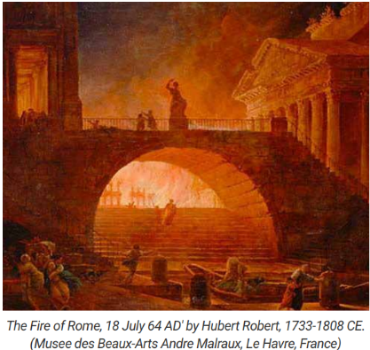
History of loss
48 BCE Great Library of Alexandria Fire
64 CE Great Fire of Rome – Ner0
1871 Great Chicago Fire ~300 deaths
1903 Chicago Iroquois Theatre Fire 602 deaths
1911 Triangle Shirtwaist Factory fire 147 deaths
26th California Unified Program
Annual Training Conference
February 26-29, 2024
Notes:
The Great Library of Alexandria fire that destroyed it is cloaked in controversy. Plutarch claims Julius Caesar started the blaze when he set his ships on fire in the harbor while trying to wrest control of the city in 48 B.C.
When Emperor Nero was 27, 70% of Rome burned. He redesigned the city with a plan that featured wider streets, restricted the height of houses and the use of common walls between buildings, and required homes and buildings to be constructed with stone or other fire-resistant materials instead of wood.
In 1872 the Chicago City Council banned wooden building materials, requiring flame-resistant materials for construction.
Iroquois Theatre violated numerous fire codes, exits were hidden behind thick black curtains, and most were locked. After the use of a fire curtain became mandatory in large theatres to prevent fires starting on stage from spreading into the auditorium. This fire also prompted the widespread use of “crash bars” on doors open in the direction of egress.
In the Factory workers trapped on the top three floors of the 10-story building. The exits had been locked to reduce theft and prevent workers from taking unauthorized breaks. Many died jumping from the windows to escape the fire while most succumbed to flames and smoke inhalation. In 1912 New York established the nation’s first fire prevention bureau charged with the development and enforcement of fire safety regulations.

Slide 6
Rules that result…
Fire resistive construction
Active automatic suppression
Compartmentalization to prevent spread
Awareness of hazards
Improved safety of response
26th California Unified Program
Annual Training Conference
February 26-29, 2024
Notes:
The Great Library of Alexandria fire that destroyed it is cloaked in controversy. Plutarch claims Julius Caesar started the blaze when he set his ships on fire in the harbor while trying to wrest control of the city in 48 B.C.
When Emperor Nero was 27, 70% of Rome burned. He redesigned the city with a plan that featured wider streets, restricted the height of houses and the use of common walls between buildings, and required homes and buildings to be constructed with stone or other fire-resistant materials instead of wood.
In 1872 the Chicago City Council banned wooden building materials, requiring flame-resistant materials for construction.
Iroquois Theatre violated numerous fire codes, exits were hidden behind thick black curtains, and most were locked. After the use of a fire curtain became mandatory in large theatres to prevent fires starting on stage from spreading into the auditorium. This fire also prompted the widespread use of “crash bars” on doors open in the direction of egress.
In the Factory workers trapped on the top three floors of the 10-story building. The exits had been locked to reduce theft and prevent workers from taking unauthorized breaks. Many died jumping from the windows to escape the fire while most succumbed to flames and smoke inhalation. In 1912 New York established the nation’s first fire prevention bureau charged with the development and enforcement of fire safety regulations.

Slide 7
Standardizing Codes in US
Prior to 1994
the National Fire Prevention Code
the Standard Fire Prevention Code
the Uniform Fire Code,
National Fire Protection Association (NFPA) 1 – Fire Prevention Code
1994, International Code Council created IFC
26th California Unified Program
Annual Training Conference
February 26-29, 2024

Slide 8
MAQ Limits are Complex
Prior to 2000, no comprehensive limits
Starting in 2001 California Fire Codes limits quantities of chemicals
Limits are by physical state at NTP, hazard type & class, locations in or near a building, type of storage, use and design of the building
26th California Unified Program
Annual Training Conference
February 26-29, 2024
Notes:
Current CFC https://codes.iccsafe.org/content/CAFC2022P2/california-code-of-regulations-title-24

Slide 9
Changes in MAQ
In 2016 CFC MAQ rules changed again
Now, the number of control areas (or lab suites) allowed on varies by floors.
A percentage reduction is imposed by floor
These are all added to the 2001 hazardous hazard class limits.
26th California Unified Program
Annual Training Conference
February 26-29, 2024
Notes:
Current CFC https://codes.iccsafe.org/content/CAFC2022P2/california-code-of-regulations-title-24

Slide 10
MAQ Reductions
Floor level (B Occupancy) |  | Percentage of the Maximum Allowable Quantity per Control Area | NUMBER OF CONTROL AREAS PER FLOOR
Above grade plane | Higher than 9 | 5 | 1
 | 7 thru 9 | 5 | 2
 | 6 | 12.5 | 2
 | 5 | 12.5 | 2
 | 4 | 12.5 | 2
 | 3 | 50 | 2
 | 2 | 75 | 3
 | 1 | 100 | 4
Below grade plane | -1 | 75 | 3
 | -2 | 50 | 2
 | Lower than -2 | Not Allowed | Not Allowed
26th California Unified Program
Annual Training Conference
February 26-29, 2024
Notes:
Flammable liquid IA 1st floor MAQ is 30 gallons. If you are on the second floor the becomes 22.5 gallons, on the 3rd floor, its 15, 4th thru 6th floors its 3.75 gallons for 7th floor and higher it is 1.5 gallons
If there are 4 PI’s in one control area, it is possible that each would get 1/3rd of a gallon
If the classification really should have been Flammable Liquids IB, or IC each of the amounts are four times larger so the PI on the 7th or higher floor can have 4 1/3rd gallons of all IB and IC flammables combined

Slide 11
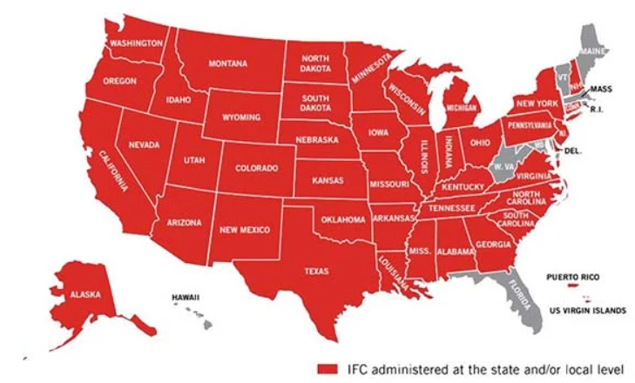
IFC is model code in most states
3/10/2020 https://blog.koorsen.com/the-international-fire-code-its-history-and-role-in-fire-safety-today
Koorsen Fire & Security
26th California Unified Program
Annual Training Conference
February 26-29, 2024

Slide 12
Chemical Hazards in Fire Code MAQ limits
Health Hazards
8
3
Physical Hazards
Combustibles
Flammable
Pyrophoric
Oxidizer
Explosives
Organic peroxide
Unstable (reactive)
Water reactive
Corrosives
Toxics
Highly Toxics
Irritants
Sensitizer
Other Health Hazard Material
26th California Unified Program
Annual Training Conference
February 26-29, 2024

Slide 13
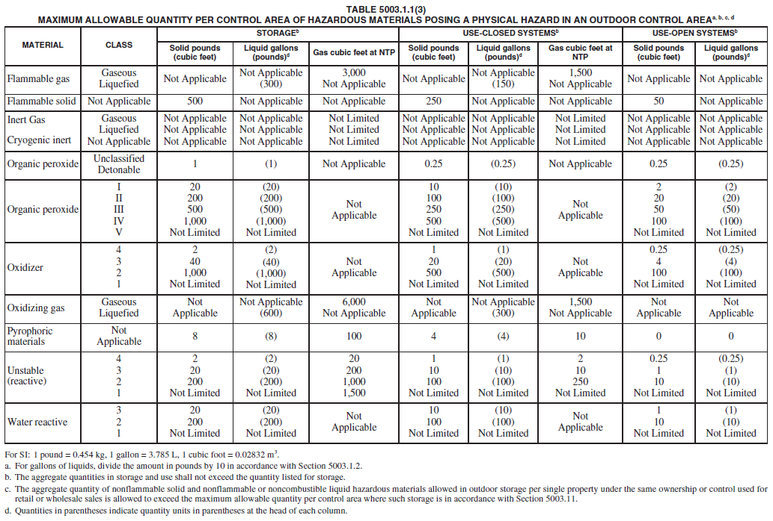
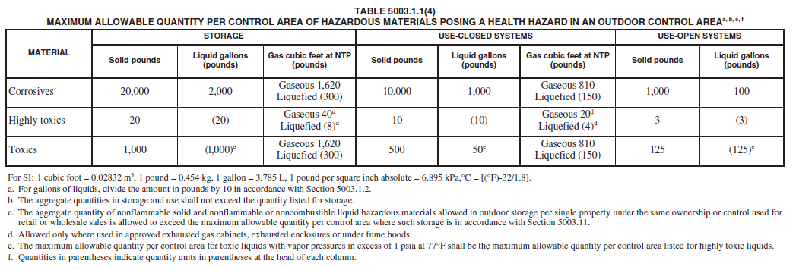
MAQ CFC Tables 5003.1.1(1-4)
Indoor Control Areas
Outdoor Control Areas
26th California Unified Program
Annual Training Conference
February 26-29, 2024
Notes:
Current CFC https://codes.iccsafe.org/content/CAFC2022P2/california-code-of-regulations-title-24

Slide 14
Compliance Challenges
Flammable liquid IA MAQ
1st floor - 30 gallons
2nd floor - 22.5 gallons
3rd floor - 15 gallons
4th thru 6th floors - 3.75 gallons
7th floor and higher - 1.5 gallons
If there are 4 lab groups in one control area, it is possible that each would get 1/3rd of a gallon for all IA flammable liquids
26th California Unified Program
Annual Training Conference
February 26-29, 2024
Notes:
If the classification really should have been Flammable Liquids IB, or IC each of the amounts are four times larger so the PI on the 7th or higher floor can have 4 1/3rd gallons of all IB and IC flammables combined
If it should have been a Flammable Liquefied Gas then the comparison converts to pounds. Looking at say butane liquefied gas, the MAQ for the 1st floor is 120 pounds = 574 gallons
Examples of Flammable Liquid IA:
Acetaldehyde (fp -40C; bp 21C), ether(fp -40C; bp -34.6C), Pentane(fp -49C; bp 35C); 2-Methylbutane (fp -51C; bp 30C)

Slide 15
Forbidden Classes
Only allowed with sprinklers
Most explosives except commercial fireworks
Organic Peroxides (UD), Oxidizer 4, Pyrophoric, Unstable (reactive) 4
Only allowed in approved exhausted gas cabinets or exhausted enclosures.
Highly Toxic Gas and Liquefied gas
26th California Unified Program
Annual Training Conference
February 26-29, 2024
Notes:
Forbidden Classes where MAQ = 0 unless conditions are met
UD = Unclassified detonable

Slide 16
Classes Not Limited
Regardless of sprinklers
Cryogenic Inert, Inert Gas both Gaseous & Liquefied gas, Organic Peroxide classes IV and V, Unstable (reactive) class 1, Water reactive class 1
Combustible Dust limited to:
Where manufactured, generated or used in such a manner that the concentration and conditions create a fire or explosion hazard (reviewed by a PE)
26th California Unified Program
Annual Training Conference
February 26-29, 2024

Slide 17
Resources
Definitions from California Fire Code about Hazard Classes (https://codes.iccsafe.org/content/CAFC2022P2/california-code-of-regulations-title-24)
GHS Pictogram Guide to CFC Hazard Classes
GHS Pictograms & Hazard Statement to IFC Hazard Class (https://codes.iccsafe.org/s/IFC2024P1/part-vii-appendices/IFC2024P1-Pt07-AppxE-SecE104.2)
GHS Classification Summary – PubChem (https://pubchem.ncbi.nlm.nih.gov/ghs/)
26th California Unified Program
Annual Training Conference
February 26-29, 2024
Notes:
Safety Data Sheets

Slide 18
Resources in pdf
Definitions from California Fire Code about Hazard Classes.pdf
GHS Pictogram Guide to CFC Hazard Classes .pdf
GHS Pictograms & Hazard Statement to IFC Hazard Class.pdf
GHS Classification Summary – PubChem.pdf
ToxicFlammable Notes.pdf
26th California Unified Program
Annual Training Conference
February 26-29, 2024
Notes:
Safety Data Sheets

Slide 19
SDS Resources
Dibenzylamine MilliporeSigma SDS 2023.06.06.pdf
DIBENZYLAMINE-ThermoFisher SDS 2021.12.24.pdf
ethyl alcohol Millipore Sigma SDS 2023.08.23.pdf
tert-butyllithium 1.7 M in pentane Millipore Sigma SDS.pdf
Acetone MilliporeSigma SDS 2023.07.25.pdf
26th California Unified Program
Annual Training Conference
February 26-29, 2024
Notes:
Safety Data Sheets

Slide 20
BREAK TIME!
26th California Unified Program
Annual Training Conference
February 26-29, 2024

Slide 21
Classes w/ quantitative definitions
Flammable & combustive Liquids
Pyrophorics
Toxic & Highly Toxic
26th California Unified Program
Annual Training Conference
February 26-29, 2024

Slide 22
Flammable & Combustible Liquids
26th California Unified Program
Annual Training Conference
February 26-29, 2024
Notes:
Let’s look at a hard one
Unstable (Reactive) Material
On the 7th floor this has no limit
Unstable (Reactive) Material
MAQ 1st floor, B occupancy
Class 4 require sprinklers – 1 pound for solid & liquids, 10 cubic feet for gas
Class 3 without sprinklers - 5 pounds for solid & liquids, 50 cubic feet for gas
Class 2 without sprinklers – 50 pounds for solid & liquids, 750 cubic feet for gas
Class 1 without sprinklers – No Limit

Slide 23
Classification Comparison
Fire Code
OSHA
Flammable Liquid, FP < 38 C
Class IA, FP < 22.8 C, BP < 37.8 C
Class IB, FP < 22.8 C, BP ≥ 37.8 C
Class IC, FP ≥ 22.8 C < 37.8 C
Combustible Liquids, FP ≥ 37.8 C
Class II, FP ≥ 37.8 C & < 60 C
Class IIIA, FP ≥ 60 C & 93.3 C
Class IIIB, FP ≥ 93.3 C
Liquid, Flammable, FP ≤ 93 C
Category 1, FP < 23 C, BP ≤ 35 C
Category 2, FP < 23 C, BP > 35 C
Category 3, FP ≥ 23 C & ≤ 60 C
Category 4, FP > 60C & ≤ 93C
≈
≈
≈
≈
26th California Unified Program
Annual Training Conference
February 26-29, 2024
Notes:
Let’s look at a hard one
Unstable (Reactive) Material
On the 7th floor this has no limit
Unstable (Reactive) Material
MAQ 1st floor, B occupancy
Class 4 require sprinklers – 1 pound for solid & liquids, 10 cubic feet for gas
Class 3 without sprinklers - 5 pounds for solid & liquids, 50 cubic feet for gas
Class 2 without sprinklers – 50 pounds for solid & liquids, 750 cubic feet for gas
Class 1 without sprinklers – No Limit

Slide 24
Flammable Liquids
Pictogram | Signal word | Hazard Statement | Hazard Code | Hazard Class
 | Danger | Extremely flammable liquid and vapor | H224, Category 1 | IA
 | Danger | Highly Flammable liquid and vapor | H225, Category 2 | IB
 | Warning | Flammable liquid and vapor | H226, Category 3 | IC
https://codes.iccsafe.org/content/IFC2024P1/appendix-e-hazard-categories
26th California Unified Program
Annual Training Conference
February 26-29, 2024
Notes:
Let’s look at a hard one
Unstable (Reactive) Material
On the 7th floor this has no limit
Unstable (Reactive) Material
MAQ 1st floor, B occupancy
Class 4 require sprinklers – 1 pound for solid & liquids, 10 cubic feet for gas
Class 3 without sprinklers - 5 pounds for solid & liquids, 50 cubic feet for gas
Class 2 without sprinklers – 50 pounds for solid & liquids, 750 cubic feet for gas
Class 1 without sprinklers – No Limit

Slide 25
Unstable (reactive) Material
A material, other than an explosive, which in the pure state or as commercially produced, will vigorously polymerize, decompose, condense or become self-reactive and undergo other violent chemical changes, including explosion, when exposed to heat, friction or shock, or in the absence of an inhibitor, or in the presence of contaminants, or in contact with incompatible materials.
Unstable (reactive) materials are subdivided as follows:
Class 4; Class 3; Class 2; Class 1
26th California Unified Program
Annual Training Conference
February 26-29, 2024
Notes:
Let’s look at a hard one
Unstable (Reactive) Material
MAQ 1st floor, B occupancy
Class 4 require sprinklers – 1 pound for solid & liquids, 10 cubic feet for gas
Class 3 without sprinklers - 5 pounds for solid & liquids, 50 cubic feet for gas
Class 2 without sprinklers – 50 pounds for solid & liquids, 750 cubic feet for gas
Class 1 without sprinklers – No Limit

Slide 26
Unstable (reactive) Material
Class 4. Materials that in themselves are readily capable of detonation or explosive decomposition or explosive reaction at normal temperatures and pressures. This class includes materials that are sensitive to mechanical or localized thermal shock at normal temperatures and pressures.
MAQ 1st floor, B occupancy, only allowed with sprinklers:
1 pounds for solid & liquids, 10 cubic feet for gas
26th California Unified Program
Annual Training Conference
February 26-29, 2024
Notes:
Let’s look at a hard one
Unstable (Reactive) Material
On the 7th floor this is 2.268 grams per control area
Unstable (Reactive) Material
MAQ 1st floor, B occupancy
Class 4 require sprinklers – 1 pound for solid & liquids, 10 cubic feet for gas
Class 3 without sprinklers - 5 pounds for solid & liquids, 50 cubic feet for gas
Class 2 without sprinklers – 50 pounds for solid & liquids, 750 cubic feet for gas
Class 1 without sprinklers – No Limit

Slide 27
Unstable (reactive) Material
Class 3. Materials that in themselves are capable of detonation or of explosive decomposition or explosive reaction but which require a strong initiating source or which must be heated under confinement before initiation. This class includes materials that are sensitive to thermal or mechanical shock at elevated temperatures and pressures.
MAQ 1st floor, B occupancy, no sprinklers:
5 pounds for solid & liquids, 50 cubic feet for gas
26th California Unified Program
Annual Training Conference
February 26-29, 2024
Notes:
Let’s look at a hard one
Unstable (Reactive) Material
On the 7th floor this is 11.43 grams per control area
Unstable (Reactive) Material
MAQ 1st floor, B occupancy
Class 4 require sprinklers – 1 pound for solid & liquids, 10 cubic feet for gas
Class 3 without sprinklers - 5 pounds for solid & liquids, 50 cubic feet for gas
Class 2 without sprinklers – 50 pounds for solid & liquids, 750 cubic feet for gas
Class 1 without sprinklers – No Limit

Slide 28
Unstable (reactive) Material
Class 2. Materials that in themselves are normally unstable and readily undergo violent chemical change but do not detonate. This class includes materials that can undergo chemical change with rapid release of energy at normal temperatures and pressures, and that can undergo violent chemical change at elevated temperatures and pressures.
MAQ 1st floor, B occupancy, no sprinklers:
50 pounds for solid & liquids, 750 cubic feet for gas
26th California Unified Program
Annual Training Conference
February 26-29, 2024
Notes:
Let’s look at a hard one
Unstable (Reactive) Material
On the 7th floor this is 114.3 grams per control area
Unstable (Reactive) Material
MAQ 1st floor, B occupancy
Class 4 require sprinklers – 1 pound for solid & liquids, 10 cubic feet for gas
Class 3 without sprinklers - 5 pounds for solid & liquids, 50 cubic feet for gas
Class 2 without sprinklers – 50 pounds for solid & liquids, 750 cubic feet for gas
Class 1 without sprinklers – No Limit

Slide 29
Unstable (reactive) Material
Class 1. Materials that in themselves are normally stable but which can become unstable at elevated temperatures and pressure.
MAQ 1st floor, B occupancy, no sprinklers:
No limit
26th California Unified Program
Annual Training Conference
February 26-29, 2024
Notes:
Let’s look at a hard one
Unstable (Reactive) Material
On the 7th floor this has no limit
Unstable (Reactive) Material
MAQ 1st floor, B occupancy
Class 4 require sprinklers – 1 pound for solid & liquids, 10 cubic feet for gas
Class 3 without sprinklers - 5 pounds for solid & liquids, 50 cubic feet for gas
Class 2 without sprinklers – 50 pounds for solid & liquids, 750 cubic feet for gas
Class 1 without sprinklers – No Limit

Slide 30
Unstable (reactive) w/ GHS
Pictogram | Signal word | Hazard Statement | Hazard Code | Hazard Class
 | Danger | Heating may cause an explosion | H240, Type A | 4
 | Danger | Heating may cause a fire or explosion | H241, Type B | 3
 | Danger | Heating may cause a fire | H242, Type C or H242, Type D | 2
 | Warning | Heating may cause a fire | H242, Type E or H242, Type F | 1
26th California Unified Program
Annual Training Conference
February 26-29, 2024
Notes:
Let’s look at a hard one
Unstable (Reactive) Material
On the 7th floor this has no limit
Unstable (Reactive) Material
MAQ 1st floor, B occupancy
Class 4 require sprinklers – 1 pound for solid & liquids, 10 cubic feet for gas
Class 3 without sprinklers - 5 pounds for solid & liquids, 50 cubic feet for gas
Class 2 without sprinklers – 50 pounds for solid & liquids, 750 cubic feet for gas
Class 1 without sprinklers – No Limit

Slide 31
Organic Peroxides w/GHS
Pictogram | Signal word | Hazard Statement | Hazard Code | Hazard Class
 | Danger | Heating may cause an explosion | H240, Organic Peroxide, Type A | UD
 | Danger | Heating may cause a fire or explosion | H241, Organic Peroxide, Type B | I
 | Danger | Heating may cause a fire | H242, Organic Peroxide, Type C or D | II
 | Warning | Heating may cause a fire | H242, Organic Peroxide, Type E | III
 | Warning | Heating may cause a fire | H242, Organic Peroxide, Type F | IV
 |  | Heating may cause a fire | H242, Organic Peroxide, Type G | V
26th California Unified Program
Annual Training Conference
February 26-29, 2024
Notes:
Let’s look at a hard one
Unstable (Reactive) Material
On the 7th floor this has no limit
Unstable (Reactive) Material
MAQ 1st floor, B occupancy
Class 4 require sprinklers – 1 pound for solid & liquids, 10 cubic feet for gas
Class 3 without sprinklers - 5 pounds for solid & liquids, 50 cubic feet for gas
Class 2 without sprinklers – 50 pounds for solid & liquids, 750 cubic feet for gas
Class 1 without sprinklers – No Limit

Slide 32
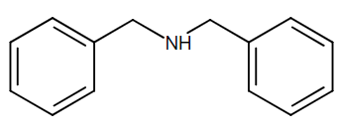
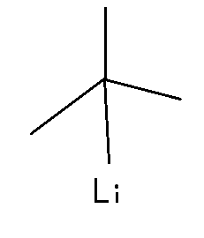
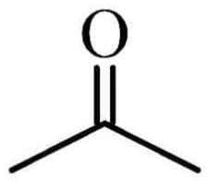
Let’s classify ☺
dibenzylamine
ethyl alcohol
tert-butyllithium
acetone
26th California Unified Program
Annual Training Conference
February 26-29, 2024

Slide 33
Short Break Time!
26th California Unified Program
Annual Training Conference
February 26-29, 2024

Slide 34
Dibenzylamine
https://commonchemistry.cas.org/
CAS: 103-49-1
Boiling Point 270 °C
Melting Point -26 °C
26th California Unified Program
Annual Training Conference
February 26-29, 2024

Slide 35
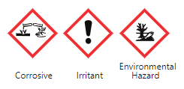
Dibenzylamine (continued)
https://pubchem.ncbi.nlm.nih.gov/
https://pubchem.ncbi.nlm.nih.gov/compound/7656
GHS Hazard Statements
H302 (99.58%): Harmful if swallowed [Warning Acute toxicity, oral]
H314 (73.31%): Causes severe skin burns and eye damage [Danger Skin corrosion/irritation]
H315 (26.69%): Causes skin irritation [Warning Skin corrosion/irritation]
H318 (36.86%): Causes serious eye damage [Danger Serious eye damage/eye irritation]
H319 (26.69%): Causes serious eye irritation [Warning Serious eye damage/eye irritation]
H410 (39.41%): Very toxic to aquatic life with long lasting effects [Warning Hazardous to the aquatic environment, long-term hazard]
H412 (20.34%): Harmful to aquatic life with long lasting effects [Hazardous to the aquatic environment, long-term hazard]
26th California Unified Program
Annual Training Conference
February 26-29, 2024

Slide 36
Dibenzylamine (continued)
https://pubchem.ncbi.nlm.nih.gov/
https://pubchem.ncbi.nlm.nih.gov/compound/7656
GHS Hazard Statements
H302 (99.58%): Harmful if swallowed [Warning Acute toxicity, oral]
H314 (73.31%): Causes severe skin burns and eye damage [Danger Skin corrosion/irritation]
H315 (26.69%): Causes skin irritation [Warning Skin corrosion/irritation]
H318 (36.86%): Causes serious eye damage [Danger Serious eye damage/eye irritation]
H319 (26.69%): Causes serious eye irritation [Warning Serious eye damage/eye irritation]
H410 (39.41%): Very toxic to aquatic life with long lasting effects [Warning Hazardous to the aquatic environment, long-term hazard]
H412 (20.34%): Harmful to aquatic life with long lasting effects [Hazardous to the aquatic environment, long-term hazard]
26th California Unified Program
Annual Training Conference
February 26-29, 2024

Slide 37
Dibenzylamine (continued 2)
Search for SDS “Dibenzylamine SDS”
Millipore Sigma https://www.sigmaaldrich.com/US/en/sds/aldrich/d34108
ThermoFisher https://www.fishersci.com/store/msds?partNumber=AC112612500&productDescription=DIBENZYLAMINE%2C+98%25+250MLDIBEN&vendorId=VN00032119&countryCode=US&language=en
26th California Unified Program
Annual Training Conference
February 26-29, 2024

Slide 38
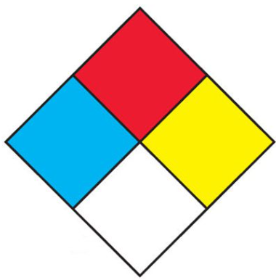
Extracted data
Sigma-Aldrich (6/6/2023)
Fisher Scientific (12/24/2021)
Danger
Harmful if swallowed.
Causes severe skin burns and eye damage.
Toxic to aquatic life.
Very toxic to aquatic life with long lasting effects.
Flash point 143 C (289 F)
Autoignition Temp 395 C (743 F)
Danger
Harmful if swallowed
Causes severe skin burns and eye damage
May cause respiratory irritation
Flash point 138 C (280 F)
Autoignition Temp 425 C (797 F)
NFPA 704
1
26th California Unified Program
Annual Training Conference
February 26-29, 2024
3
0

Slide 39
GHS Pictogram Guide to CFC Hazard Classes
Sigma-Aldrich
Fisher Scientific
Danger
Harmful if swallowed
Causes severe skin burns and eye damage
May cause respiratory irritation
Danger
Harmful if swallowed.
Causes severe skin burns and eye damage.
Toxic to aquatic life.
Very toxic to aquatic life with long lasting effects.
26th California Unified Program
Annual Training Conference
February 26-29, 2024

Slide 40
Extracted Toxicity Data
MilliporeSigma-Aldrich
ThermoFisher Scientific
Acute toxicity
LD50 Oral - Rat - female - 632 mg/kg
Inhalation: No data available
LD50 Dermal - Rat - > 2,000 mg/kg
Skin corrosion/irritation
Skin – Rabbit: Corrosive, category 1C
Acute toxicity
LD50 Oral 632 mg/kg (Rat)
LC50 Inhalation Not listed
LD50 Dermal>2000 mg/kg (Rat)
26th California Unified Program
Annual Training Conference
February 26-29, 2024

Slide 41
CFC Definitions
NTP state = Liquid (boiling point > 20 C, melting point < 20 C) @ 1atm
Toxic
LD50 is greater than 50 mg/kg and less than 500 mg/kg in rat, oral
LC50 is greater than or equal to 200 ppmv and less than 2000 ppmv OR LC50 is greater than 2 mg/L and less than 20 mg/L in rat, inhalation, 1 hr or less
LD50 is greater than 200 mg/kg and less than 1000 mg/kg, rabbit, dermal
Corrosive
…visible destruction of, or irreversible alterations in, living tissue by chemical action at the point of contact. … intact skin of albino rabbits…following an exposure period of 4 hours. This term does not refer to action on inanimate surfaces.
26th California Unified Program
Annual Training Conference
February 26-29, 2024

Slide 42
Combustible Liquid IIIB No GHS Hazard Statement or pictogram
OSHA Based on GHS
Fire Code Based on IFC
Flammable Liquid, FP < 38 C
Class IA, FP < 22.8 C, BP < 37.8 C
Class IB, FP < 22.8 C, BP ≥ 37.8 C
Class IC, FP ≥ 22.8 C < 37.8 C
Combustible Liquids, FP ≥ 37.8 C
Class II, FP ≥ 37.8 C & < 60 C
Class IIIA, FP ≥ 60 C & 93.3 C
Class IIIB, FP ≥ 93.3 C
Liquid, Flammable, FP ≤ 93 C
Category 1, FP < 23 C, BP ≤ 35 C
Category 2, FP < 23 C, BP > 35 C
Category 3, FP ≥ 23 C & ≤ 60 C
Category 4, FP > 60C & ≤ 93C
≈
≈
≈
≈
26th California Unified Program
Annual Training Conference
February 26-29, 2024
Notes:
Let’s look at a hard one
Unstable (Reactive) Material
On the 7th floor this has no limit
Unstable (Reactive) Material
MAQ 1st floor, B occupancy
Class 4 require sprinklers – 1 pound for solid & liquids, 10 cubic feet for gas
Class 3 without sprinklers - 5 pounds for solid & liquids, 50 cubic feet for gas
Class 2 without sprinklers – 50 pounds for solid & liquids, 750 cubic feet for gas
Class 1 without sprinklers – No Limit

Slide 43
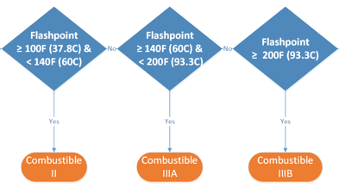
CFC Definitions
Combustible Liquids
A liquid having a closed cup flash point at or above 100°F (38°C). Combustible liquids shall be subdivided as follows:
Class II. Liquids having a closed cup flash point at or above 100°F (38°C) and below 140°F (60°C).
Class IIIA. Liquids having a closed cup flash point at or above 140°F (60°C) and below 200°F (93°C).
Class IIIB. Liquids having closed cup flash points at or above 200°F (93°C).
26th California Unified Program
Annual Training Conference
February 26-29, 2024

Slide 44
RSS Dibenzylamine Classifications at UC
Fire Code Hazard Class
MAQ 1st floor B, No Sprinklers
Combustible Liquid : IIIB
Irritant (CFC2001)
Corrosive Liquid
13,200 gal
No Limit (2001 CFC)
500 gal
26th California Unified Program
Annual Training Conference
February 26-29, 2024

Slide 45
Let’s classify ☺
dibenzylamine
ethyl alcohol
tert-butyllithium
acetone
26th California Unified Program
Annual Training Conference
February 26-29, 2024

Slide 46
Ethyl alcohol
Sigma-Aldrich (8/23/2023) CAS [64-17-5]
Danger
Highly flammable liquid and vapor.
Causes serious eye irritation.
Flammable liquids (Category 2)H225
Eye irritation (Category 2A), H319
BP: 78 C (172 F)
FP: 13 C (55 F)
AIT: 363-425 C (685-797 F)
UEL: 27.7 %
LEL: 3.1 %
LD50 Oral – Rat: 10,470 mg/kg
LC50 Inhalation – Rat, 4h: 124.7 mg/L
Skin - Rabbit: No skin irritation
26th California Unified Program
Annual Training Conference
February 26-29, 2024

Slide 47
Ethyl alcohol compare to resources
From SDS | GHS guide | CFC Definition
Danger; Highly flammable liquid and vapor.” | Flammable Liquid IB
FP: 13 C (55 F); BP: 78 C (172 F)” |  | Flammable Liquids Class IB. Liquids flash point < 73°F (23°C) and boiling point ≥ 100°F (38°C).
Flammable liquids (Category 2), H225 | Flammable Liquid IB
Eye irritation (Category 2A), H319 | Irritant (CFC2001) | eye irritant 16 C.F.R. 1500.42 or other approved techniques.
26th California Unified Program
Annual Training Conference
February 26-29, 2024
Notes:
Eye irritation test https://ntp.niehs.nih.gov/sites/default/files/iccvam/suppdocs/feddocs/cpsc/cpsc_1500_42.pdf

Slide 48
RSS Ethanol Classifications at UC
Fire Code Hazard Class |  | MAQ 1st floor B, No Sprinklers
Flammable Liquid : IB, IC |  | 120 gal
Flammable Liquid : IA, IB, IC |  | 120 gal
Irritant (CFC2001) |  | No Limit (2001 CFC)
26th California Unified Program
Annual Training Conference
February 26-29, 2024

Slide 49
Let’s classify ☺
dibenzylamine
ethyl alcohol
tert-butyllithium
acetone
26th California Unified Program
Annual Training Conference
February 26-29, 2024

Slide 50
tert-butyllithium 1.7 M in pentane
Sigma-Aldrich
H225 Highly flammable liquid and vapor.
H250 Catches fire spontaneously if exposed to air.
H260 In contact with water releases flammable gases which may ignite spontaneously.
H304 May be fatal if swallowed and enters airways.
H314 Causes severe skin burns and eye damage.
H336 May cause drowsiness or dizziness.
Autoignition Temperature (AIT) = No data available
Flash Point= -49 C (-56 F)
Boiling Point = No data
Acute toxicity estimate Inhalation - 4 h - 30.1 mg/l - vapor
26th California Unified Program
Annual Training Conference
February 26-29, 2024

Slide 51
t-butyllithium 1.7 M in pentane
Pictogram | Hazard Statements (Signal Word - Danger) | GHS Classification | CFC Hazard Class
 | Highly flammable liquid and vapor. | Flammable liquids (Cat 2), H225 | Flammable Liquid IB
 | Catches fire spontaneously if exposed to air. | Pyrophoric liquids (Cat 1), H250 | Pyrophoric
 | In contact with water releases flammable gases which may ignite spontaneously. | Chemicals which, in contact with water, emit flammable gases (Cat 1), H260 | Water Reactive 3
 | May be fatal if swallowed and enters airways. | Aspiration hazard (Cat 1), H304 | Other Health Hazard Material
 | May cause drowsiness or dizziness. | Specific target organ toxicity - single exposure (Cat 3), Central nervous system, H336 | Other Health Hazard Material
 | Causes severe skin burns and eye damage. | Skin corrosion (Cat 1B), H314 Serious eye damage (Cat 1), H318 | Corrosive
26th California Unified Program
Annual Training Conference
February 26-29, 2024
Notes:
Eye irritation test https://ntp.niehs.nih.gov/sites/default/files/iccvam/suppdocs/feddocs/cpsc/cpsc_1500_42.pdf

Slide 52
RSS t-butyllithium 1.7 M in pentane Classifications at UC
Fire Code Hazard Class |  | MAQ 1st floor B, No Sprinklers
Flammable Liquid : IB, IC |  | 120 gal
Flammable Liquid : IA, IB, IC |  | 120 gal
Irritant (CFC2001) |  | No Limit (2001 CFC)
Other Health Hazard Material |  | No Limit (2001 CFC)
26th California Unified Program
Annual Training Conference
February 26-29, 2024

Slide 53
Let’s classify ☺
dibenzylamine
ethyl alcohol
tert-butyllithium
acetone
26th California Unified Program
Annual Training Conference
February 26-29, 2024

Slide 54
Acetone
Sigma-Aldrich
Highly flammable liquid and vapor.
Flammable liquids (Cat 2), H225
Causes serious eye irritation.
Eye irritation (Cat 2A), H319
May cause drowsiness or dizziness.
Specific target organ toxicity - single exposure (Cat 3), Central nervous system, H336
26th California Unified Program
Annual Training Conference
February 26-29, 2024

Slide 55
RSS Acetone Classifications at UC
Fire Code Hazard Class |  | MAQ 1st floor B, No Sprinklers
Flammable Liquid : IB, IC |  | 120 gal
Flammable Liquid : IA, IB, IC |  | 120 gal
Irritant (CFC2001) |  | No Limit (2001 CFC)
Other Health Hazard Material |  | Not Included
26th California Unified Program
Annual Training Conference
February 26-29, 2024

Slide 56
Let’s classify ☺
dibenzylamine
ethyl alcohol
tert-butyllithium
acetone
26th California Unified Program
Annual Training Conference
February 26-29, 2024

Slide 57
Common Chemicals Extra Credit
Solid
Sodium hydroxide
Aluminum oxide
Sodium bicarbonate
Calcium carbonate
Liquid
Sulfuric acid
Benzene
Ethanol
Ethylene glycol
Acetic acid
Acetone
Hydrochloric acid
Formaldehyde (aq)
Ammonia (aq)
Sodium hydroxide (aq)
Gas
Ethylene
Ammonia
Propylene
Chlorine
Nitrogen
Formaldehyde
26th California Unified Program
Annual Training Conference
February 26-29, 2024

Slide 58
Summary
No need to have a chemistry degree
Seemingly arbitrary and complicated regulations can be the basis for employment
Making reasonable approximations of hazard classes can be fun ☺
26th California Unified Program
Annual Training Conference
February 26-29, 2024

Slide 59
Additional Resources
NIST
https://webbook.nist.gov/chemistry/
https://www.nist.gov/pml/productsservices/physical-reference-data
UNECE GHS
https://unece.org/transport/dangerous-goods/ghs-rev10-2023
CFC 2022
https://codes.iccsafe.org/content/CAFC2022P2/california-code-of-regulations-title-24
NIH NLM PubChem
https://pubchem.ncbi.nlm.nih.gov/ghs/
All suppliers who sell to people who are required to provide SDS to the people who obtain use the hazardous material* in their work
*as defined by OSHA, excludes ‘articles’, additives and alcoholic beverages, cosmetics, drugs and pharmaceuticals, hazardous wastes & remediation, tobacco & tobacco products, wood & lumber, consumer products, non-hazardous nuisance particulates & dust, ionizing & non-ionizing radiation, biological hazards, office & school supplies
26th California Unified Program
Annual Training Conference
February 26-29, 2024
Notes:
National Institute of Standards and Technology (US Dept of Commerce)
United Nations Economic Commission for Europe
California Fire Code
National Institutes of Health, National Library of Medicine,

Slide 60
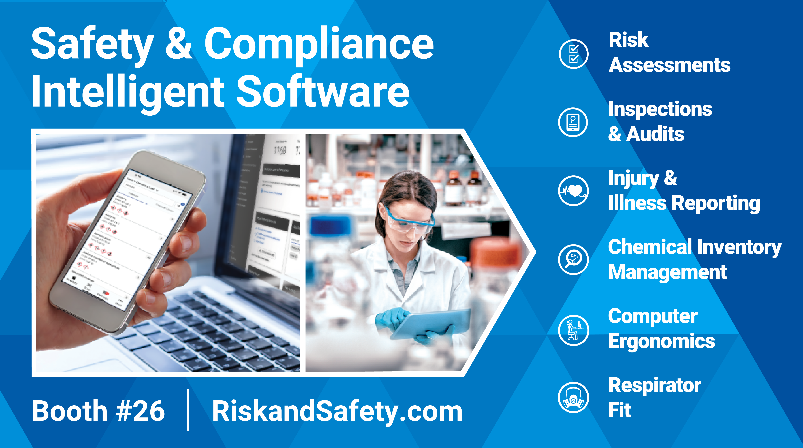
RSS booth
26th California Unified Program
Annual Training Conference
February 26-29, 2024

Slide 61
Any Questions?
Russ Vernon, Ph.D., EH&S Business Development Manager
Risk and Safety Solutions
University of California
rnvernon@ucdavis.edu | RiskandSafety.com
www.linkedin.com/in/russellvernon
26th California Unified Program
Annual Training Conference
February 26-29, 2024

